Slide 1

By – Ankit Verma
Business Analyst Career Program - Capstone Project

Slide 2

Agenda
Data Exploration
Statistical Analysis using Excel
Graphical Analysis using Excel
Insert the given data into the SQL server
Import the Data from the SQL Database into PowerBI
Interactive Dashboard by using visualization tools
Conclusion and Inferences
Endnotes

Slide 3
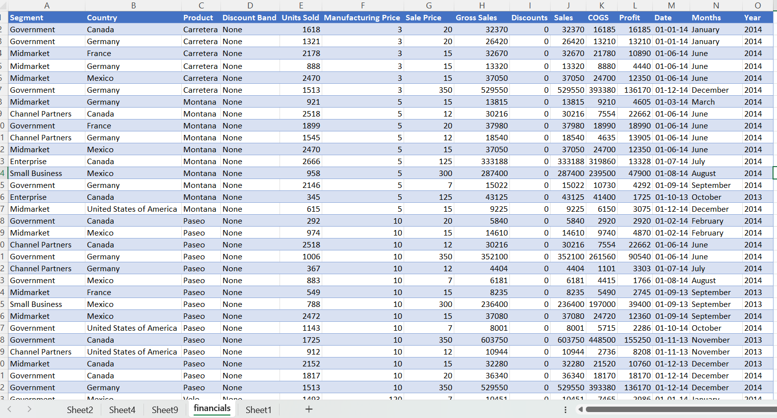
Data Exploration
Q. 1) Explore the Data using Excel. Understand the data and prepare a short summary about the dataset.

Slide 4
Summary
From the given dataset we has used excel power query for cleaning dataset .
We changed the dollar currency to decimal number and changed text also for some columns .
In given dataset we found some important data sales profits discount segment , products, Country wise .
In some country we found product wise sales are increase and discount is none but in some country’s we gives discounts to customers .
Here some numbers of from given dataset unit of sold , total sales , total profit , total discount .

Slide 5
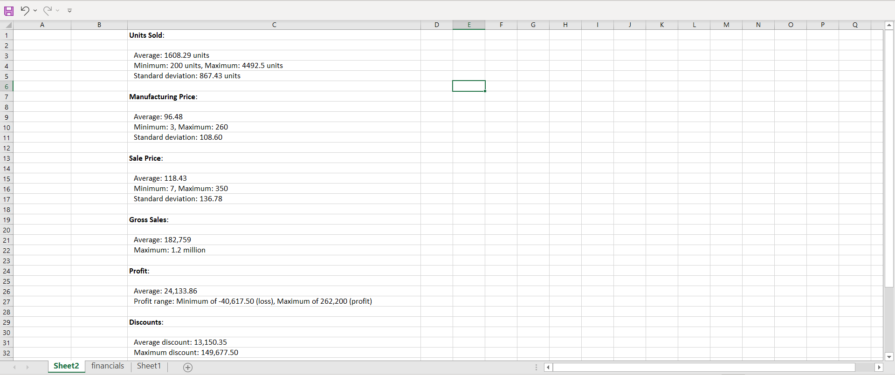
Statistical Analysis using Excel
Q. 2) Perform Data cleaning if required and then do Statistical Analysis on data using statistical tools.

Slide 6
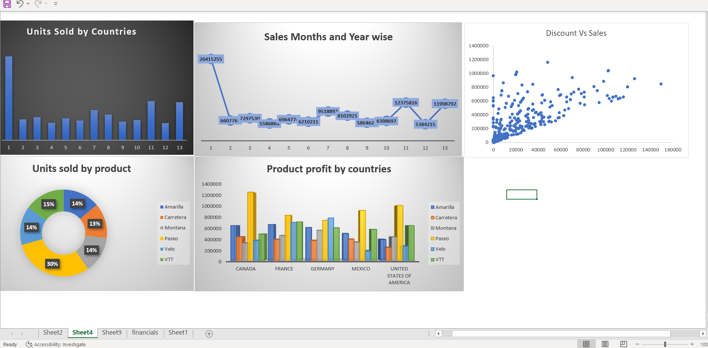
Graphical Analysis using Excel
Q .3) Perform Graphical Analysis on the Data using Excel and Derive insights from it.

Slide 7
Insights Derived
Sales Trends: Analyze which months have the highest sales volumes.
You can adjust marketing and inventory planning accordingly.
Product Performance: Pie charts show which products perform better in specific countries.
Profit Margins: The column chart helps identify which products or countries yield the highest profits.
Discount Strategy: The scatter plot reveals if higher discounts lead to increased sales or not.

Slide 8
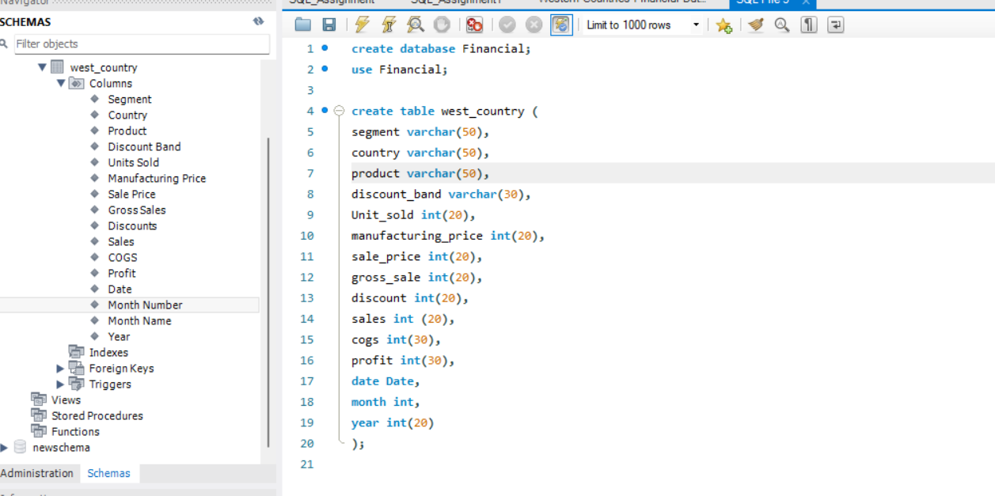
Insert the given data into the SQL server
Q. 4) Insert the given data into the SQL server by making a Database and defining the required parameters for the construction of Database and Database tables.

Slide 9
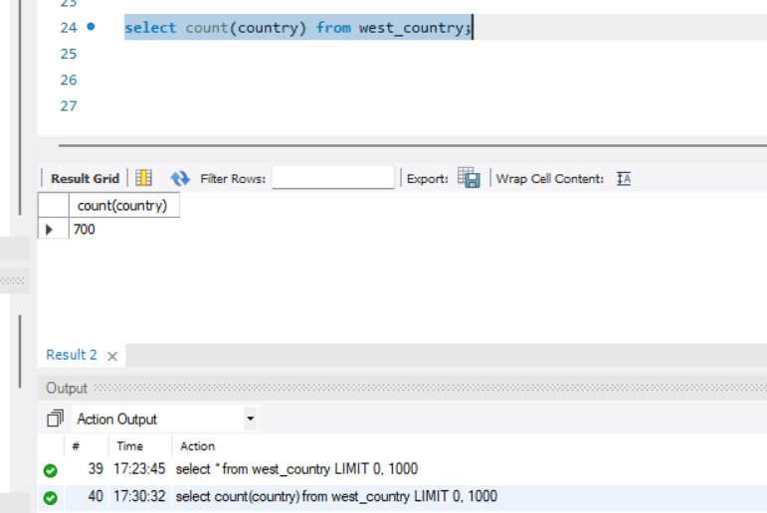
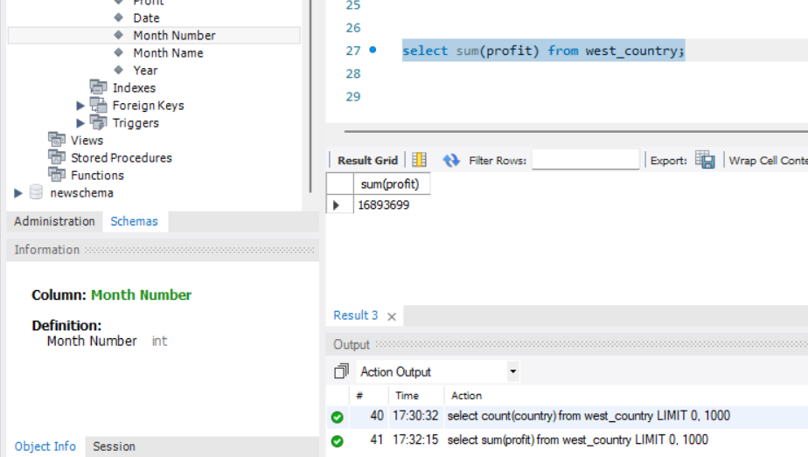
SQL Running Few Queries
Q. 5 )Verify if the data is properly imported into the SQL database (Try running few Queries)

Slide 10
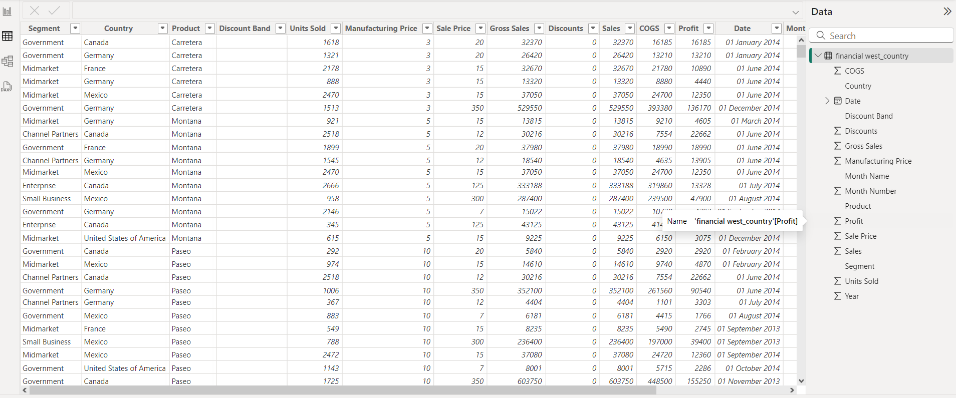
Import the Data from the SQL Database into PowerBI
Q. 6) Import the Data from the SQL Database into PowerBI, verify if the data is properly imported or not

Slide 11
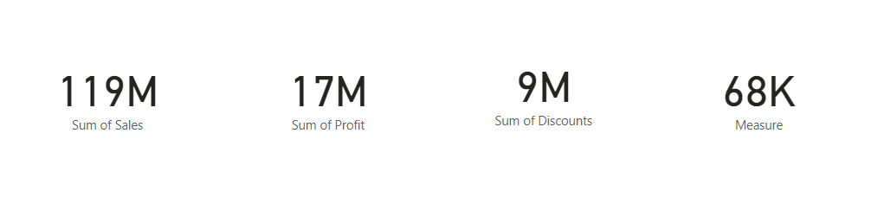
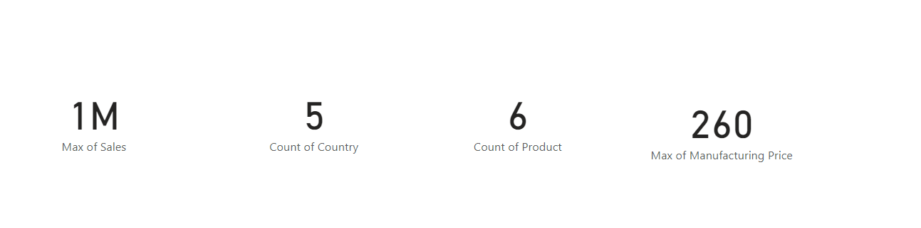
Measures & Interactive Visualization
Q. 7) Perform Data cleaning and other possible operations on data using query editor, create measures if necessary and use them to Visualize the data and make an interactive visualization

Slide 12
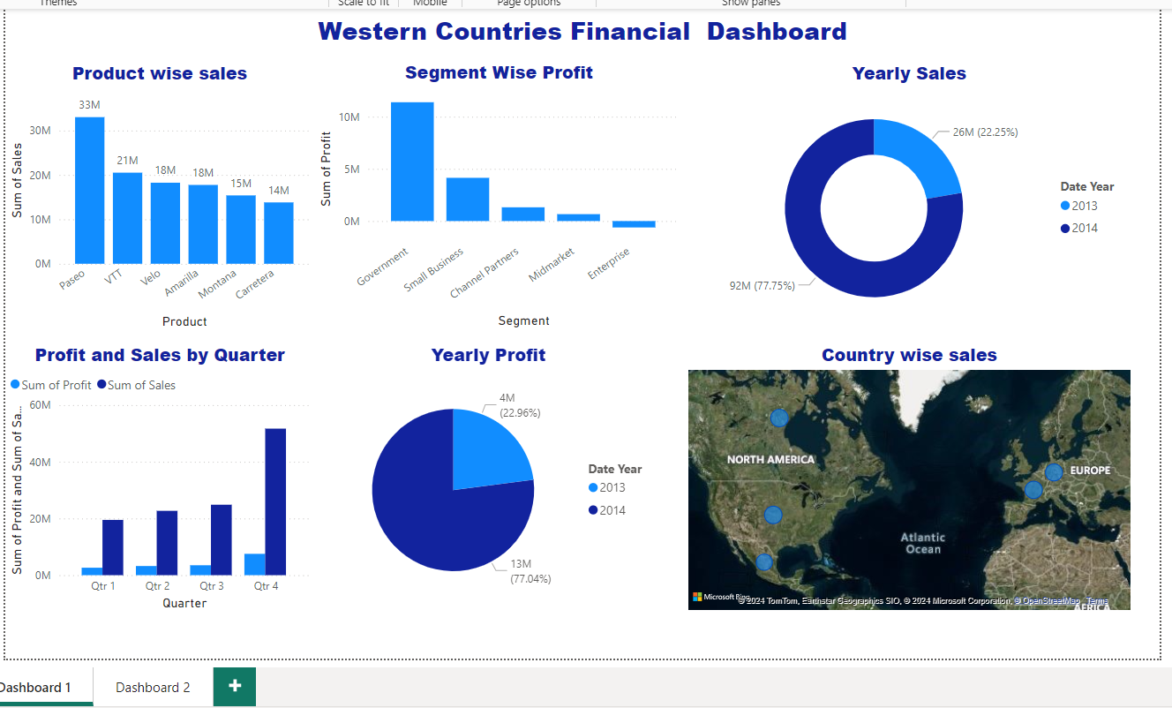
Western Countries Interactive Dashboard - 1

Slide 13
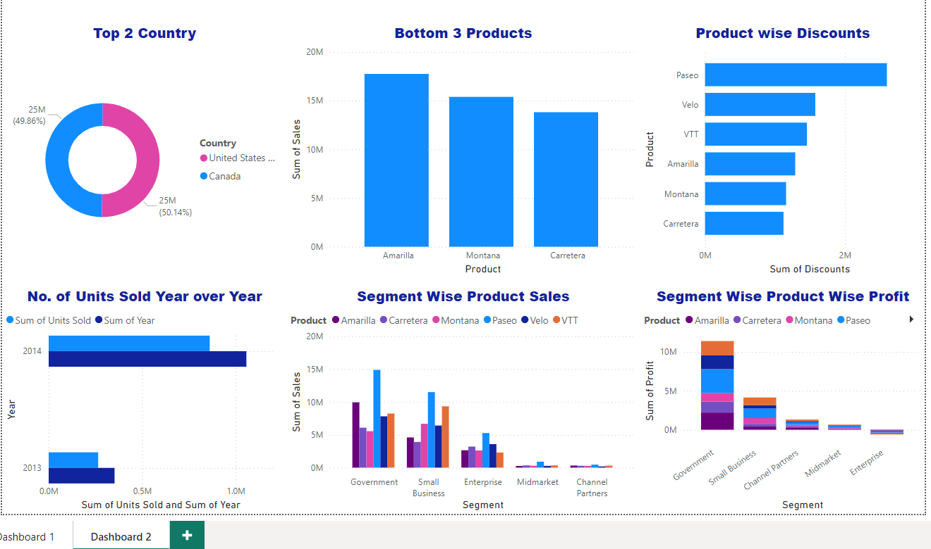
Western Countries Interactive Dashboard-2

Slide 14
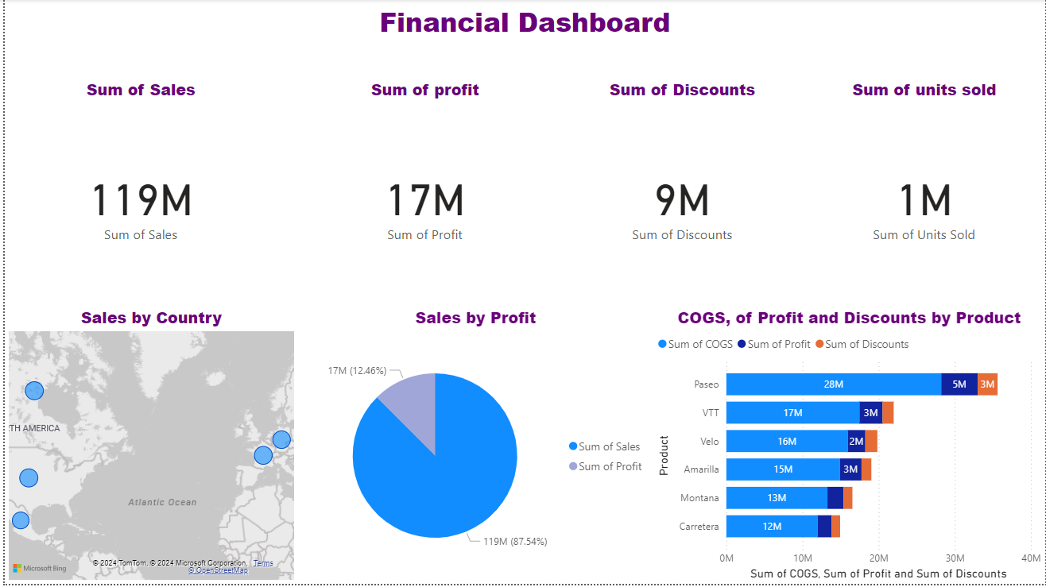
Visually pleasing Dashboard report
Q. 9) Create a Visually pleasing Dashboard report by following the rules of making the Dashboard

Slide 15
Conclusion and Inferences
Data Preparation
Data Cleaning:
Ensure there are no missing values.
Handle potential outliers in numerical columns (e.g., Units Sold, Sale Price, Profit).
Data Structuring:
Summarize data by key dimensions such as Country, Segment, Product, and Year.
Calculate new fields if necessary, such as Profit Margin (Profit/Sales).
Statistical Analysis
Descriptive Statistics:
Analyze key metrics such as average sales, average profit, total discounts, and cost of goods sold by country, segment, and year.
Identify any significant trends in terms of sales growth, profit trends, and unit sales.
Correlation Analysis:
Check for correlations between Units Sold, Sales, COGS, and Profit.
Assess how discounts impact profit.
Time Series Analysis:
Analyze the time-based data to see sales/profit growth or decline by month and year.

Slide 16
Conclusion and Inferences
Graphical and Visualization Analysis Using Excel
Sales by Country:
Create a bar chart showing the Total Sales and Profit by country. This will help identify which countries contribute the most to sales and profits.
Profit vs. Sales:
Scatter plot to compare Profit against Sales to understand the relationship between the two variables and identify if higher sales consistently result in higher profit.
Trend Analysis:
Line charts for sales and profit over time (monthly/yearly) to visualize trends.
Segment Analysis:
Pie charts or bar charts showing the breakdown of Sales and Profit by Segment to understand the distribution across different customer segments (e.g., Government, Midmarket).
Product Performance:
A stacked column chart showing sales performance by Product to identify which products are driving the most revenue and profit.
Discount Effect:
A histogram or bar chart showing the distribution of discounts and their impact on sales and profit, analyzing whether discounts helped drive higher unit sales and if that compensated for the lower per-unit price.

Slide 17
Conclusion and Inferences
Advanced Visualization Using Power BI
In Power BI, we can create dynamic dashboards to explore the data interactively:
Sales & Profit by Country Map:
Use a map visualization in Power BI to show Sales and Profit geographically, providing a visual representation of the best-performing regions.
Segment-Wise Breakdown:
Create interactive bar charts and slicers to filter data by Segment to understand how each customer segment contributes to sales and profit across different countries and products.
Time-Based Analysis:
Build a time series line chart that tracks Sales and Profit over months/years, and add filters for Country and Segment so you can drill down into the data dynamically.
Product Performance:
Compare the performance of different products using bar charts and highlight products that consistently outperform in terms of profit.
Discount Impact Dashboard:
Create a dashboard to examine the relationship between Discounts and Sales by different segments and countries. Use slicers to filter by Year, Product, or Country.

Slide 18
Conclusion and Inferences
Inferences and Conclusion
Country Performance:
Identify which countries (e.g., Canada, Germany, France) contribute the most to revenue and profit.
In some cases, countries with lower unit sales might still have higher profitability due to lower costs or higher profit margins.
Segment Analysis:
Which segments (e.g., Government vs. Midmarket) generate higher sales? The Government segment might have lower price sensitivity compared to the Midmarket.
Product Insights:
Certain products (e.g., Carretera) may consistently perform well across all countries, while others may be more region-specific.
Time-Based Sales Trends:
Are there seasonal sales trends? For example, sales might peak in certain months (like December), indicating that discount campaigns or holiday seasons drive higher sales.
Discount Impact:
Discounts may increase units sold but reduce profit margins. The analysis could show an optimal discount band that maximizes profit while driving higher unit sales.
Profitability:
Certain countries or segments might have lower COGS, leading to higher profitability even with fewer units sold.

